Slide 1
光纤透镜, 神经网络大小

Slide 2
Lensed fiber (光纤透镜)
1. highpak.com
2. 西安盛佳光电 (raysung.cn/cn/)
3. 苏州波弗光电(bonphot.com)
4. IDIL
5. 深圳艾孚光电

Slide 3
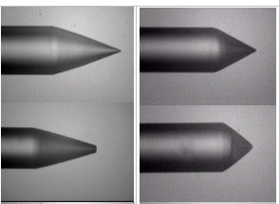
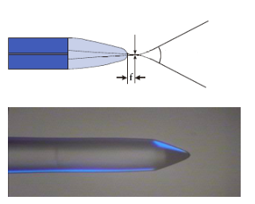
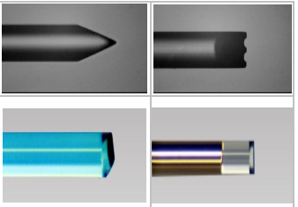
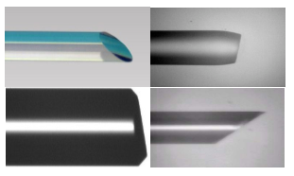
Highpak
highpak.com/fibre.html
Lensed fiber , lensed fiber assembly, and fiber array are available in single mode, PM fiber, D-shape fiber and multi mode fiber; in conical, wedge, angle and other customer tip shapes with/without AR coating.
类别
Lensed Fibre / Metalized Fibre
Long-focus Lensed Fibre / Metalized Fibre
Cylindrical Lensed/Wedged Fibre
Angle Polished Fibre (0~10° or 30 - 50°
1
2
4
3
highpak.com/fibre.html
进度: 未回复

Slide 4
可能需要提供的参数:
Wavelength, type of fiber, single more or multi-mode fiber? e.g. SFM-28,or PM1300, HI1060, etc. (波长, 光纤类型)
Type of lens: conical, wedge/cylindrical lens, or angled cylindrical lens, etc. (镜头类型)
Radius or lens, or far-field angle, or spot size. (半径或透镜, 远视场角, 光斑大小等光学参数)
Stripe length for lensed fiber, dimension of fiber assembly
Total length, connector, AR coating? (总长度等)
Quantity (数量)

Slide 5
西安盛佳光电
raysung.cn/
可以实现球形, 锥形, 楔形, 斜楔形, 斜面多种形状
对透镜的光斑, 远场等参数进行测试
额外: 金属化, 镀高反膜, FC封装, 加光纤光栅
咨询结果
他们的测试工艺是红外波段
可以提供光纤, 我们设计, 按照我们的要求进行加工. (前提: 光纤规格符合他们机器的要求, 包层是250(普通的康宁等)的都可以.)
QQ: 191528965

Slide 6
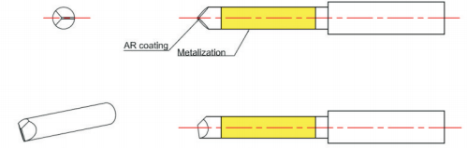
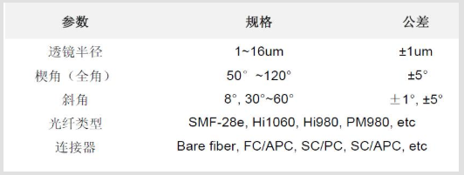
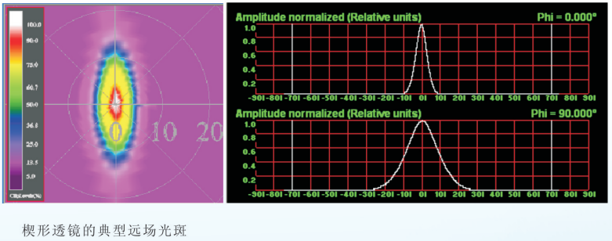
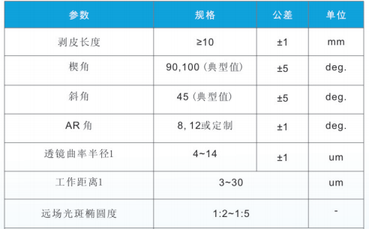
斜楔形光纤透镜
raysung.cn/

Slide 7
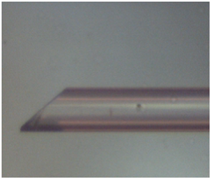
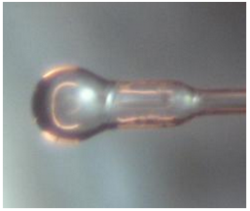
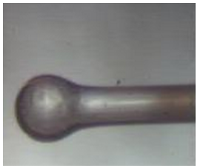
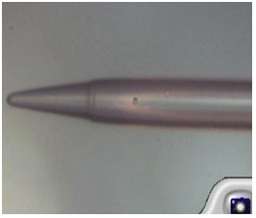
苏州波弗光电
http://www.bonphot.com/cp/html/?754.html
斜面光纤 (1)
大工作距离透镜光纤 (2) (3)
锥形透镜单模光纤 (4)
咨询结果:
代理, 网址: www.wttechnology.com.
微信: 13584890322

Slide 8
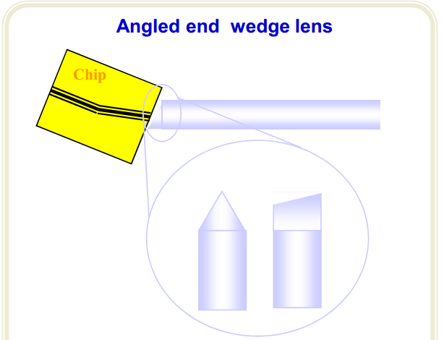
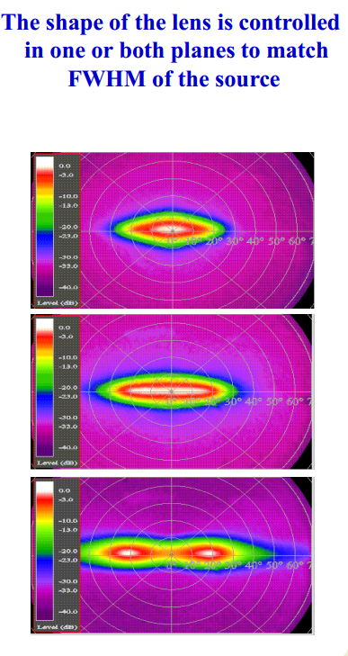
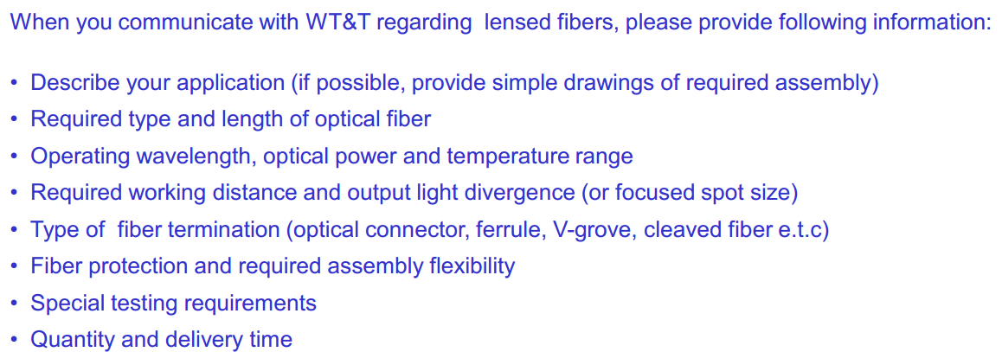
wttechnology
different wavelengths: 405, 677, 860, 980, 1300 - 2000 nm
Manufacturing cycle: 1 – 3 weeks
光路翻折?

Slide 9
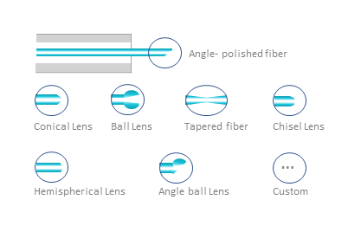
IDIL
https://www.idil-fibres-optiques.com/product/end-fiber-shaping/
angle polishing, angle lens (角型), conical lens (圆锥), conical lens with flat top, tapered lens, ball lens (球状), ball lens with large working distance, wedge angle (screw driver) lens (楔形), prism lens (棱镜), 8° to 45° face angle lens (面角镜), graded index(折射率渐变), cleave(劈开), splice (拼接) and others.

Slide 10
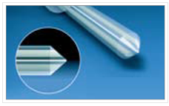
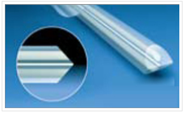

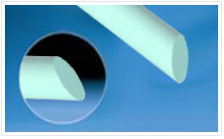
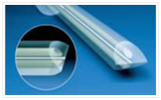
深圳艾孚光电
efprecise.com
正在联系
微信: 15361621944

Slide 11
神经网络典型值

Slide 12
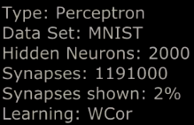
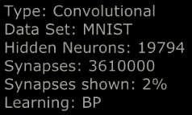
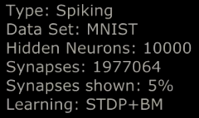
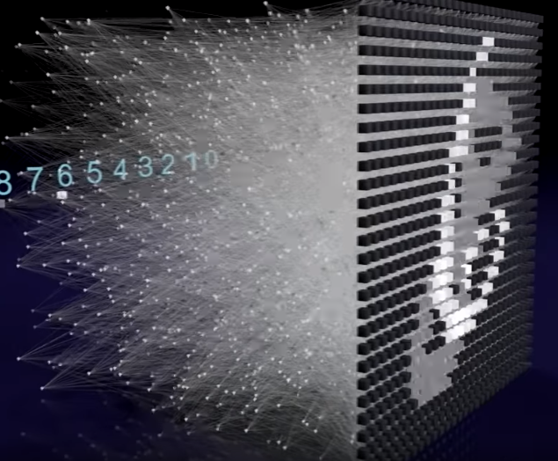
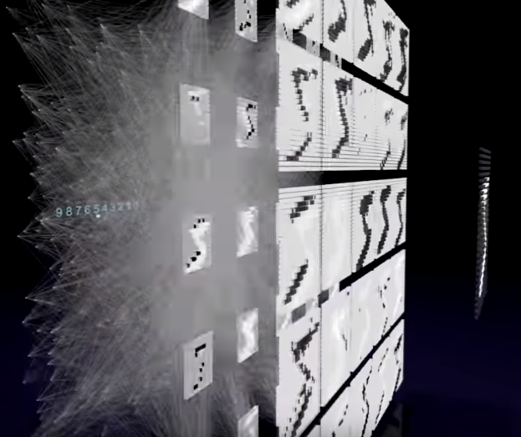
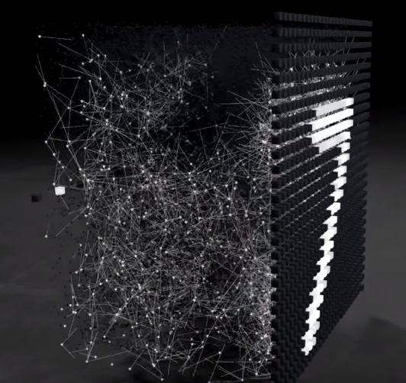
Video: Neural Network 3D Simulation
https://www.youtube.com/watch?v=3JQ3hYko51Y

Slide 13
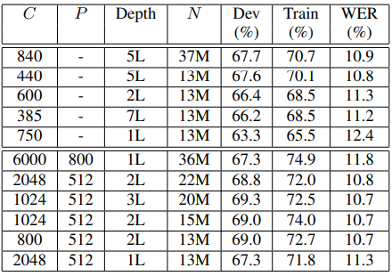
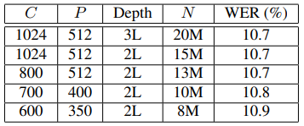
Recurrent neural network based language model
Long Short-Term Memory Recurrent Neural Network Architectures for Large Scale Acoustic Modeling
input vector: 30000 – 200000
size of hidden layer: 30 – 500
starting learning rate: 0.1
Experiments with LSTM and LSTMP RNN architectures
Experiments with LSTMP RNN architectures
C: number of memory cells
P: number of recurrent projection units
N: total number of parameters
https://www.isca-speech.org/archive/interspeech_2010/i10_1045.html
https://www.isca-speech.org/archive/interspeech_2014/i14_0338.html

Slide 14
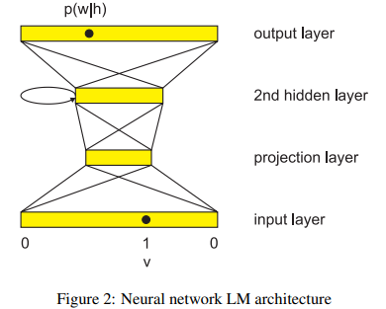
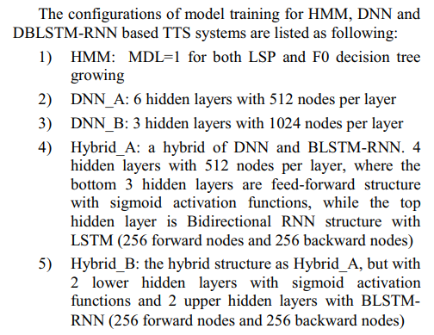
LSTM Neural Networks for Language Modeling
TTS Synthesis with Bidirectional LSTM based Recurrent Neural Networks
input feature vector: 355 dimensions
1-of-K coding (K: number of words in the vocabulary)
150 hidden nodes corresponds to 7.6 M parameters
350 hidden nodes corresponds to 7.1 M parameters
https://www.isca-speech.org/archive/interspeech_2012/i12_0194.html
https://www.isca-speech.org/archive/interspeech_2014/i14_1964.html

